Slide 1


Modelling and Forecasting India’s Gross Bank Credit:
A Comparative Study of ARIMA, ARIMAX, VECM, and FAVAR Models
Mentor: Dr. Leena Kulkarni
Presented by:
A040 - ATHARVA RAUT
A041 - VAIDEHI THAKARE
A042 - PRAANALIE CHAKRABORTY
A044 - SHREYA SAWANT
A045 - PRUTHVIRAJ DESHMUKH

Slide 2

AGENDA
INTRODUCTION
COMPARISION
01
05
02
CONCLUSION
06
OBJECTIVE
03
DATA DESCRIPTION
07
REFERENCES
04
ANALYSIS

Slide 3


INTRODUCTION
Gross Bank Credit is the total amount of loans and advances that banks have given to borrowers
(like individuals, businesses, and government entities) before subtracting any provisions or bad loans.
Gross Bank Credit (GBC) = Total loans and advances given by banks
Shows economic growth and activity
Higher GBC → more investment & consumption
Helps policymakers monitor credit trends
Used by Reserve Bank of India for analysis

Slide 4

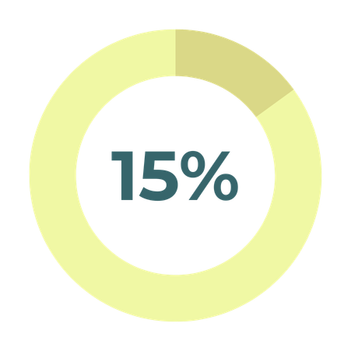
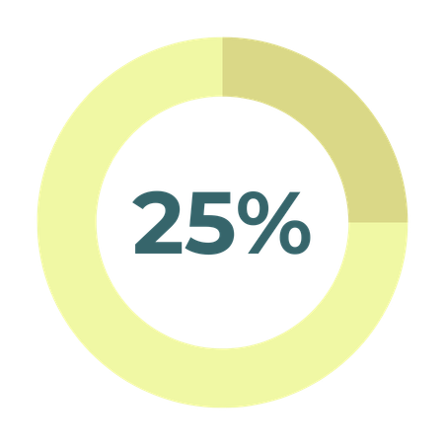
OBJECTIVES
Forecast gross bank credit demand using univariate and multivariate time-series models.
Examine long-run and short-run relationships among sectoral credit components using ARIMAX and VECM.
Incorporate high-dimensional information through a FAVAR framework for improved forecasting performance.
Compare the predictive accuracy and dynamic responses of Exponential Smoothing, ARIMA, ARIMAX, VAR/VECM, and FAVAR models.

Slide 5

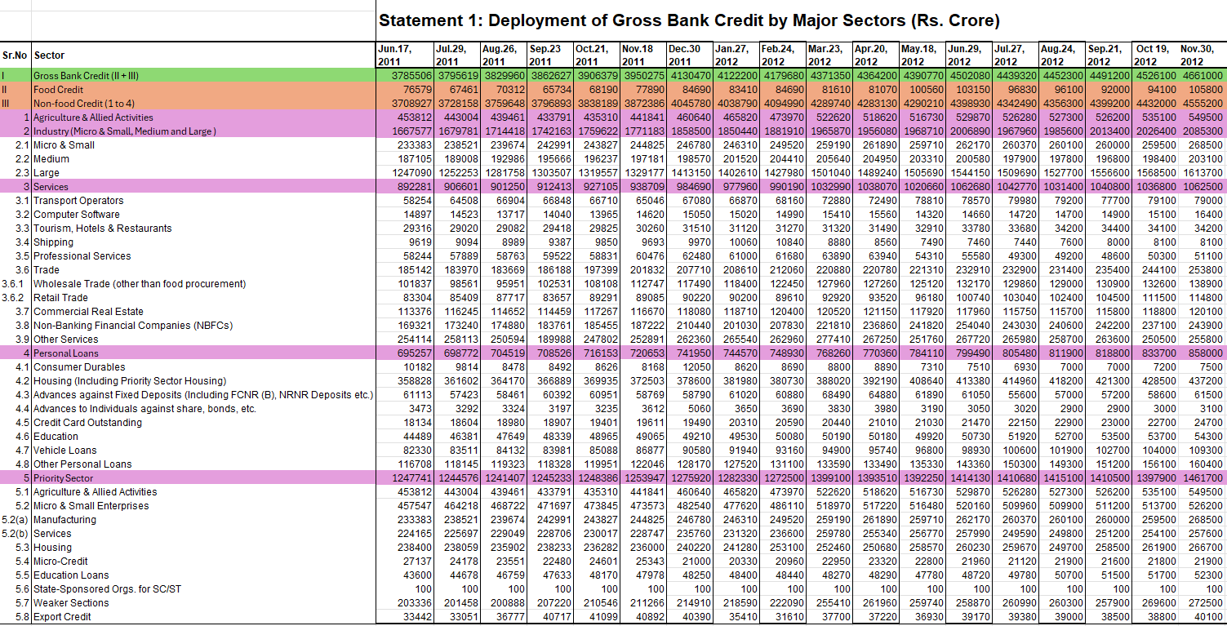
MAIN DATASET

Slide 6

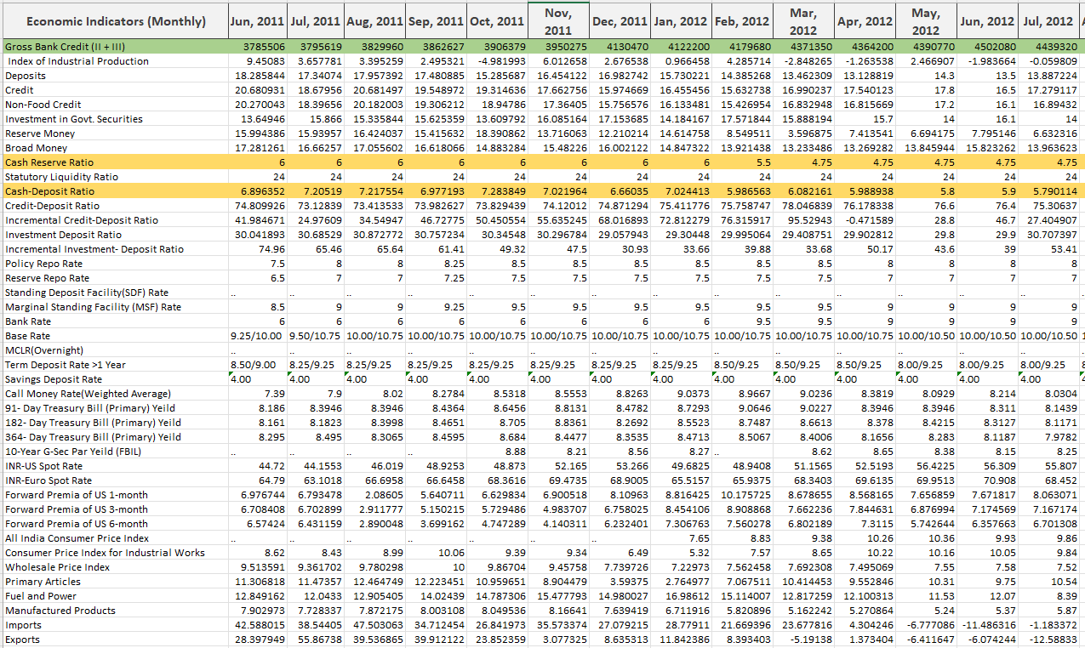
EXTERNAL VARIABLE

Slide 7
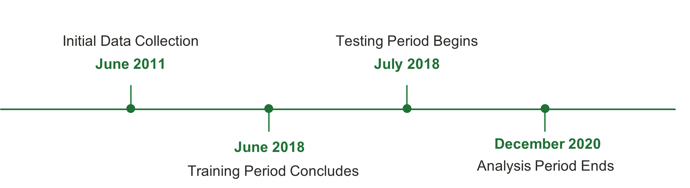
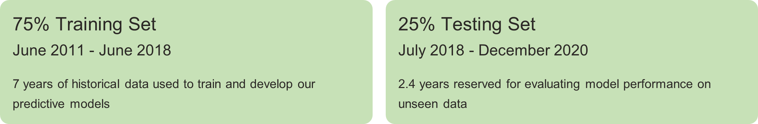
DATA TIMELINE

Slide 8
DATA USEAGE
GROSS CREDIT
FOOD
AGRICULTURE
INDUSTRY
SERVICE
PERSONAL LOAN
GROSS CREDIT
CRR
CDR
GROSS CREDIT
41 EXTERNAL VARIABLES

Slide 9
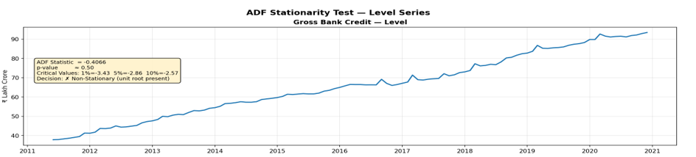
STATIONARITY CHECK
The ADF test p-value is greater than or aprrox 0.05 indicating the data is Non-stationary.

Slide 10
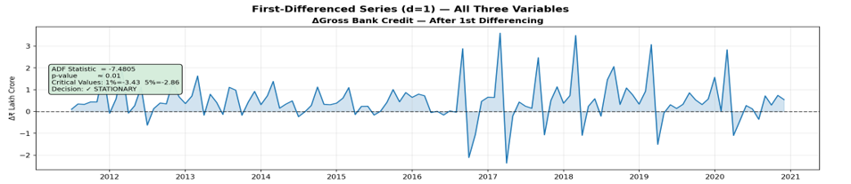
STATIONARITY CHECK
The ADF test after DIFFERENCING p-value are less than indicating the data is now Stationary.

Slide 11
STATIONARITY CHECK ​
VARIABLE | LEVEL DECISION | DIFF DECISION
Food Credit | Non-Stationary | Stationary
Agriculture & Allied | Non-Stationary | Stationary
Industry | Non-Stationary | Stationary
Services | Non-Stationary | Stationary
Personal Loans | Non-Stationary | Stationary
Index of Industrial Production | Stationary | Stationary
Deposits | Non-Stationary | Stationary
Non-Food Credit | Non-Stationary | Stationary
Investment in Govt. Securities | Non-Stationary | Stationary
Reserve Money | Non-Stationary | Stationary
Broad Money | Stationary | Stationary
Cash Reserve Ratio | Non-Stationary | Stationary
Statutory Liquidity Ratio | Non-Stationary | Stationary
Cash-Deposit Ratio | Non-Stationary | Stationary
Credit-Deposit Ratio | Stationary | Stationary
Incremental Credit-Deposit Ratio | Stationary | Stationary
Investment Deposit Ratio | Stationary | Stationary
Incremental Investment- Deposit Ratio | Stationary | Stationary
Policy Repo Rate | Non-Stationary | Stationary
Primary Articles | Non-Stationary | Stationary
Fuel and Power | Non-Stationary | Stationary
Manufactured Products | Non-Stationary | Stationary
VARIABLE | LEVEL DECISION | DIFF DECISION
Reserve Repo Rate | Non-Stationary | Stationary
Marginal Standing Facility (MSF) Rate | Non-Stationary | Stationary
Bank Rate | Non-Stationary | Stationary
Savings Deposit Rate | Non-Stationary | Stationary
Call Money Rate(Weighted Average) | Non-Stationary | Stationary
91- Day Treasury Bill (Primary) Yeild | Non-Stationary | Stationary
182- Day Treasury Bill (Primary) Yeild | Non-Stationary | Stationary
364- Day Treasury Bill (Primary) Yeild | Non-Stationary | Stationary
10-Year G-Sec Par Yeild (FBIL) | Non-Stationary | Stationary
Forward Premia of US 1-month | Non-Stationary | Stationary
Forward Premia of US 3-month | Non-Stationary | Stationary
Forward Premia of US 6-month | Non-Stationary | Stationary
All India Consumer Price Index | Non-Stationary | Stationary
Consumer Price Index for Industrial Work | Non-Stationary | Stationary
Wholesale Price Index | Non-Stationary | Stationary
Imports | Non-Stationary | Stationary
Exports | Stationary | Stationary
Log_Gross_Bank_Credit | Non-Stationary | Stationary
Log_INR_USD | Non-Stationary | Stationary
Log_INR_EUR | Non-Stationary | Stationary

Slide 12
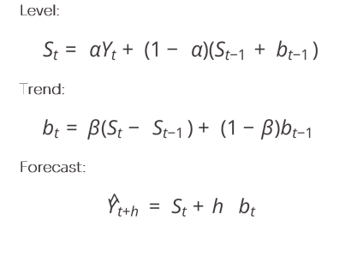
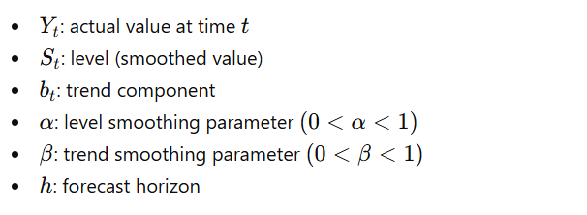
01
HOLT’S METHOD
A time series forecasting technique used to model data with trend but no seasonality. It assigns more weight to recent observations and captures both level and trend via two smoothing equations
Core Equations
Parameters

Slide 13
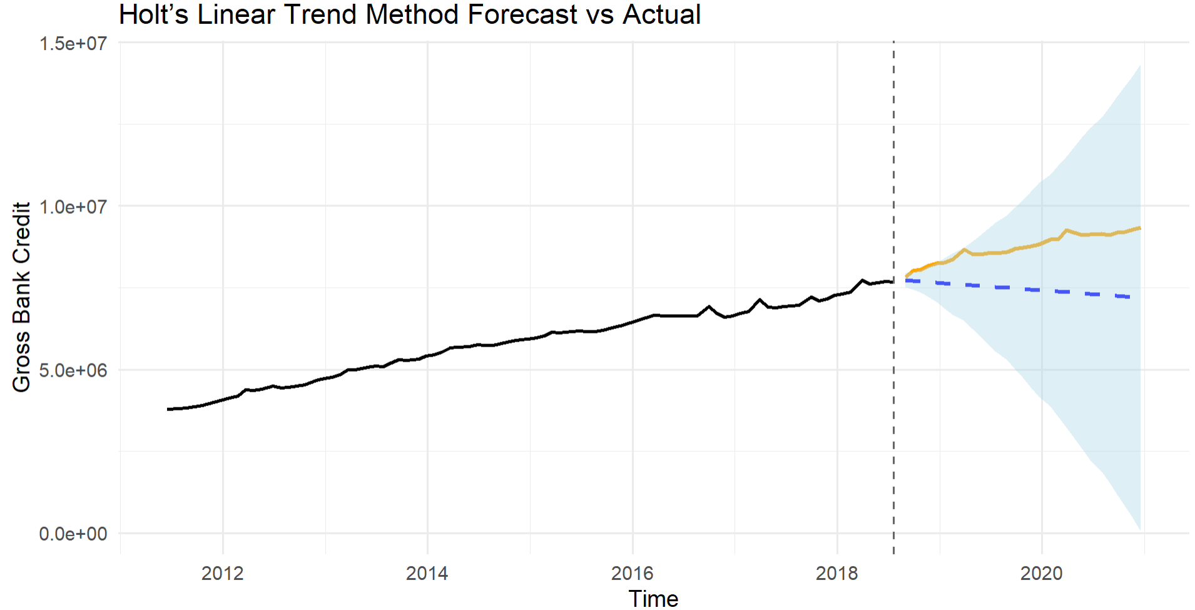
01
Exponential Smoothing Method
FORECAST ACCURACY
Holt's Method V/S Actual
Variable | RMSE (Rs. Cr) | MAPE
GROSS BANK CREDIT | 1408776.5 | 14.66%

Slide 14

02
ARIMA MODEL
The ARIMA model is expressed as a combination of autoregressive terms, differencing, and moving average terms to capture all temporal dependencies.
Yt — Current Value
The value of the time series at time t, which the model aims to predict based on past observations and error terms.
ϕ — AR Coefficients
The autoregressive parameters ϕ₁ … ϕ_p weight the influence of past values Y_{t-1} through Y_{t-p} on the current value.
θ — MA Coefficients
The moving average parameters θ₁ … θ_q weight the influence of past forecast errors e_{t-1} through e_{t-q} to correct predictions.
c — Constant Term
Represents the intercept or drift in the model, capturing any consistent upward or downward trend in the series.

Slide 15
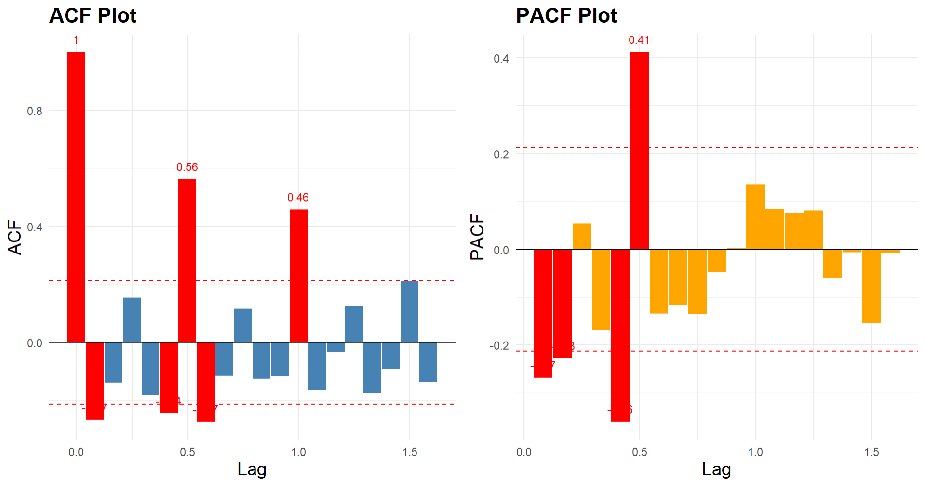
02
MODEL IDENTIFICATION
ACF and PACF after 1st differencing (d=1) - Model Order Identification
Model | AIC | BIC | Log-Likelihood | Rank
ARIMA(0,1,1) | 2160.49 | 2167.78 | −1077.24 | 1st (BEST)

Slide 16

02
MODEL ESTIMATION
The ARIMA(0,1,1) model, also known as an Integrated Moving Average or IMA(1,1) is identified as optimal. The model equation in terms of the differenced series Δyₜ:
STEP 1
μ is the drift term, θ₁ is the MA(1) coefficient, εₜ ~ N(0, σ²) is white noise
All parameters are estimated using Maximum Likelihood Estimation (MLE).
Parameter | Coefficient | p-Value | Sig.
μ (drift / x1) | 46,540.40 | <0.001 | ***
θ₁ (ma.L1) | −0.0223 | 0.549 | n.s.
σ² (variance) | 7.734 × 10⁹ | <0.001 | ***

Slide 17
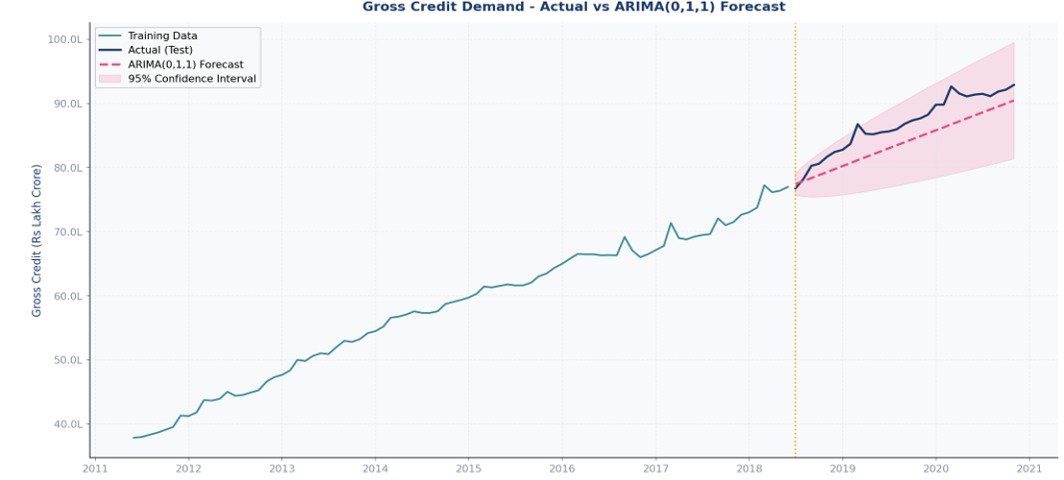
02
FORECAST ACCURACY
Gross Credit Demand – Actual V/S ARIMA(0,1,1)
STEP 1
Variable | RMSE (Rs. Cr) | MAPE
GROSS BANK CREDIT | 309,724 | 3.289%

Slide 18
VECM:
03
Vector Error Correction Model
Vector Error Correction Model is a multivariate time series model used when variables are non-stationary I(1) but cointegrated.
It captures both; short-run dynamics between variables & long-run equilibrium relationship.
If a set of variables are Cointegrated, deviations from the long-run equilibrium are corrected over time through an error correction mechanism.
ΔXt = αβ'Xt-1 + Σ Γᵢ ΔXt-i + μ + εt
Xt = vector of endogenous variables , ΔXt = first differences (short-run changes)
αβ'Xt-1 Error Correction Term – Long Run adjustment
Γᵢ ΔXt-i Lagged Differences – Short Run Dynamics
α Adjustment Matrix - speed of adjustment toward equilibrium
β Cointegrating Vector - long-run equilibrium relationship
Key Decomposition: Π = αβ' where rank(Π) = r (0 < r < k) ➜ r = number of cointegrating vectors

Slide 19
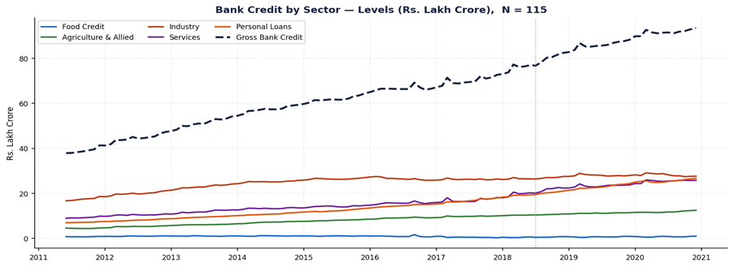
03
DATASET OVERVIEW
Code | Series
y1 | Food Credit
y2 | Agriculture & Allied
y3 | Industry
y4 | Services
y5 | Personal Loans
A key feature of this dataset is the exact additive relationship between the five sector variables and total Gross Bank Credit.
STEP 1
STEP 2
Gross Bank Credit _{t} = y_{1t} + y_{2t} + y_{3t} + y_{4t} + y_{5t}

Slide 20
03
JOHANSEN PROCEDURE
Before applying the Johansen test, the VAR lag length (p) is selected by estimating unrestricted VAR models and comparing information criteria.
STEP 2
Lag p | AIC | BIC | Recommendation
p = 1 | -39.1092 | -38.2471 | ← AIC & BIC minimum ✓
All criteria (AIC, BIC) are minimised at p = 1. The VECM uses p = 1 lag in levels
Johansen Test Results: Individual Hypothesis Tests. (Cointegrating rank r = 3)
Null Hypothes | Trace Stat | CV 5% | Trace Decision | Max-Eig Stat | CV 5% | Max Decision | Eigenvalue λ̂
H0: r = 0 | 117.93 | 68.52 | Reject ✓ | 50.08 | 33.46 | Reject ✓ | 0.4491
H0: r ≤ 1 | 67.85 | 47.21 | Reject ✓ | 32.19 | 27.07 | Reject ✓ | 0.3184
H0: r ≤ 2 | 35.66 | 29.68 | Reject ✓ | 22.22 | 20.97 | Reject ✓ | 0.2324
H0: r ≤ 3 | 13.44 | 15.41 | Accept | 11.99 | 14.07 | Accept | 0.1330
H0: r ≤ 4 | 1.45 | 3.76 | Accept | 1.45 | 3.76 | Accept | 0.0171

Slide 21
03
ESTIMATION OF PARAMETERS
The Cointegrating Vector Matrix β: The three cointegrating vectors β₁,β₂,β₃ are estimated as the eigenvectors of the reduced-rank regression matrix corresponding to the three largest eigenvalues λ̂₁, λ̂₂, λ̂₃
STEP 2
Variable | β₁ (CV1) | β₂ (CV2) | β₃ (CV3)
y1: Food Credit | 1.0000 | 1.0000 | 1.0000
y2: Agriculture & Allied | -17.8785 | -2.6235 | 3.6523
y3: Industry | 6.1866 | -1.4256 | -7.8027
y4: Services | -9.2633 | -0.9737 | 16.9592
y5: Personal Loans | 18.6320 | 4.4550 | -11.9765
ECT1_{t} = ln(Food)_{t} - 17.879 ln(Agri)_{t} + 6.187 ln(Indus_{)t} - 9.263 ln(Serv)t + 18.632 ln(PL)_{t}
ECT2_{t} = ln(Food)_{t} - 2.624 ln(Agri)_{t} - 1.426 ln(Indus)_{t} - 0.974ln(Serv)_{t} + 4.455 ln(PL)_{t}
ECT3_{t} = ln(Food)_{t} + 3.652 ln(Agri)_{t} - 7.803 ln(Indus)_{t} + 16.959 ln(Serv)_{t} - 11.977 ln(PL)_{t}
Each of equations represents a linear combination of the five log-credit series that is stationary.

Slide 22
03
ESTIMATION OF PARAMETERS
The Loading Matrix α: The loading matrix α is estimated by OLS regression of ΔY_{t} on the three ECTs (β'Y_{{t-1}}) and the constant μ
ΔY_{t} = α [ECT1_{{t-1}}, ECT2_{{t-1}}, ECT3_{{t-1}}]' + μ + ε_{t}
STEP 2
Variable | α₁ (Loading on ECT1) | α₂ (Loading on ECT2) | α₃ (Loading on ECT3)
y1: Food Credit | -0.03146 | -0.52062 | -0.03875
y2: Agriculture & Allied | 0.00861 | 0.00701 | -0.00036
y3: Industry | 0.01180 | -0.00300 | -0.00337
y4: Services | 0.01376 | 0.02147 | -0.02024
y5: Personal Loans | 0.00173 | 0.00378 | -0.00465
The constant vector μ is estimated along with α and captures sector-specific trend growth that is not explained by the error correction mechanism.
Component | μ₁ (Food) | μ₂ (Agri) | μ₃ (Indus) | μ₄ (Serv) | μ₅ (PL)
Estimated μᵢ | 2.17155 | 0.07624 | 0.19108 | 0.43671 | 0.10044

Slide 23
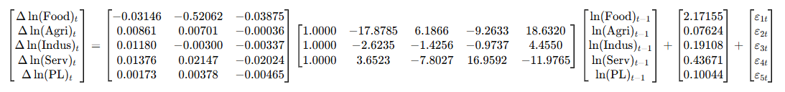
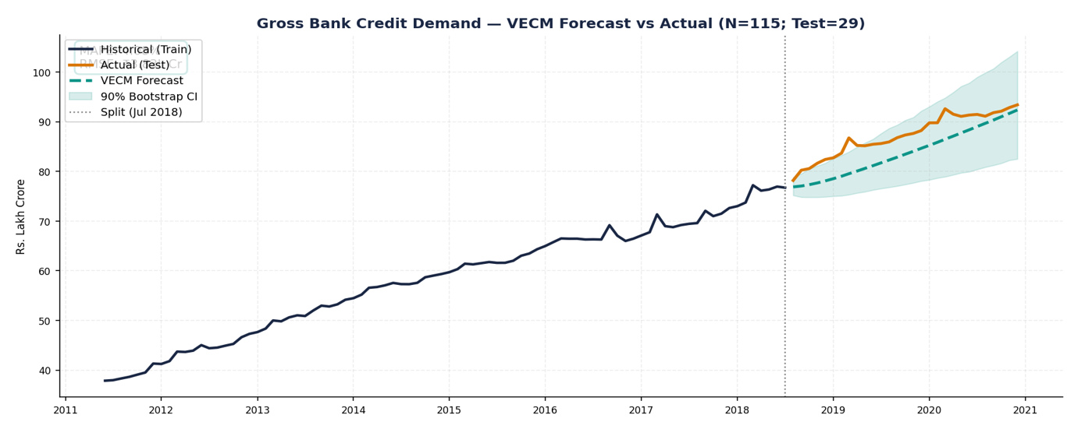
03
FORECAST ACCURACY
The multi-step forecast is generated by recursively applying this estimated VECM equation forward from the last training observation
STEP 2
Variable | RMSE (Rs. Cr) | MAPE
GROSS BANK CREDIT | 383,269 | 4.08%

Slide 24
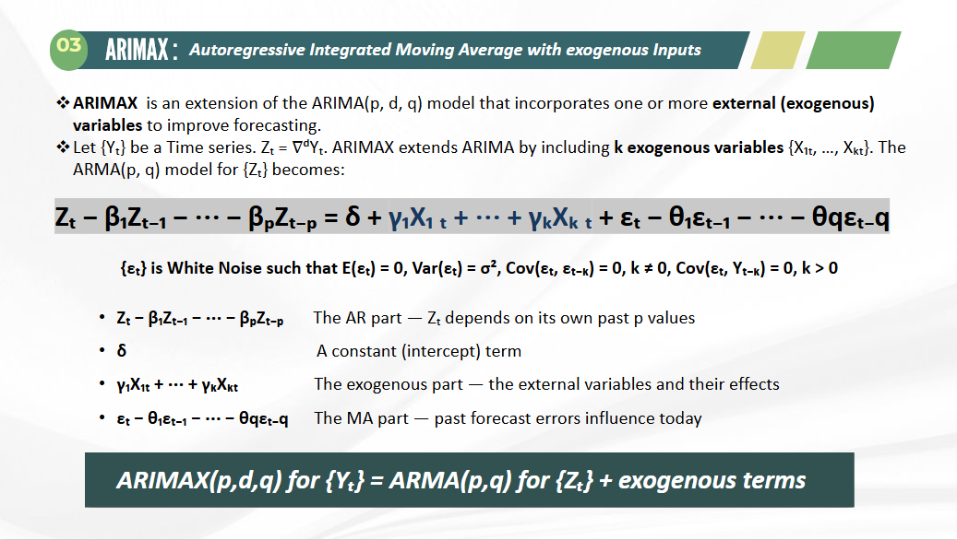
04

Slide 25
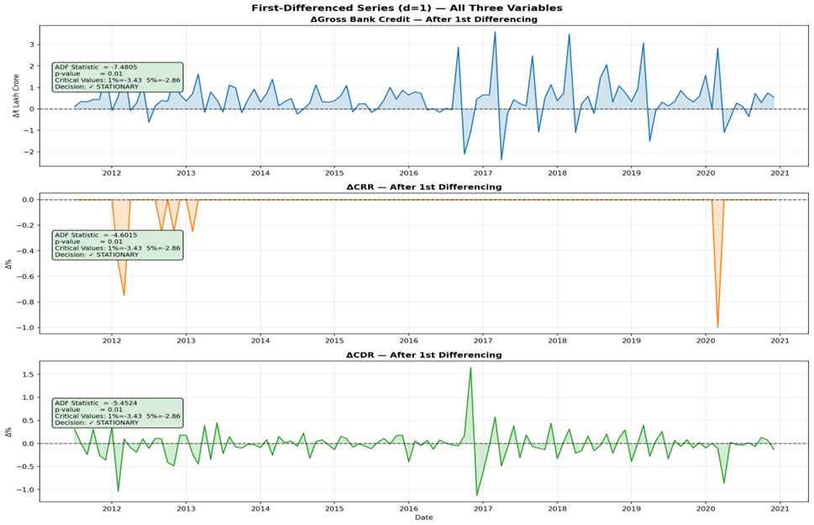
04
DATASET OVERVIEW
Objective: Forecast India's Gross Bank Credit using Cash Reserve Ratio (CRR) and Cash-Deposit Ratio (CDR) as exogenous variables.
Variable | ADF Stat (Level) | p-value | Decision | ADF Stat (Δ) | p-value | Decision
CRR | −3.1769 | > 0.05 | ✗ Non-Stationary | −4.6015 | < 0.01 | ✓ Stationary
CDR | −3.0844 | > 0.05 | ✗ Non-Stationary | −5.4524 | < 0.01 | ✓ Stationary
STEP 1
STEP 2

Slide 26
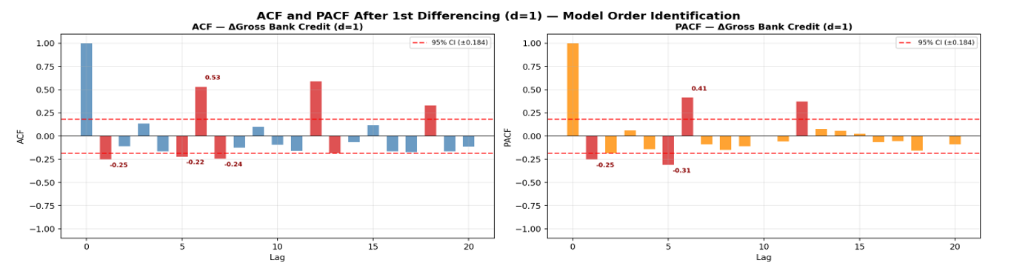
04
MODEL ORDER IDENTIFICATION
With d=1, the next step is to identify the AR order (p) and MA order (q) from the ACF and PACF of the first-differenced Gross Credit series
STEP 1
STEP 2
Model | AIC | BIC | LB p-val | Pass?
ARIMAX(6,1,1) * | 2001.72 | 2025.41 | 0.8751 | ✓

Slide 27
04
MODEL SPECIFICATION & PARAMETER ESTIMATION
The final model is ARIMAX(6,1,1) — an ARIMA model of order (6,1,1) augmented with two exogenous variables (CRR and CDR). After applying d=1 first differencing to define Δy_{t}=y_{t}−y_{t−1}, the model in the differenced space is:
STEP 1
STEP 2
Parameter Estimation:
The parameters of the ARIMAX(6,1,1) model were estimated using the Maximum Likelihood Estimation (MLE) method
Parameter | Coefficient | p-value | Sig.
AR(1) [φ₁] | -0.2354 | 0.0328 | **
AR(2) [φ₂] | -0.0929 | 0.2461
AR(3) [φ₃] | -0.0114 | 0.8872
AR(4) [φ₄] | -0.1143 | 0.1791
AR(5) [φ₅] | -0.1769 | 0.0399 | **
AR(6) [φ₆] | +0.5635 | 0.0000 | ***
MA(1) [θ₁] | +0.1538 | 0.3150
CRR [β₁] | -90,001 | 0.0000 | ***
CDR [β₂] | -13,594 | 0.1869
Intercept [μ] | +45,740 | 0.0000 | ***

Slide 28
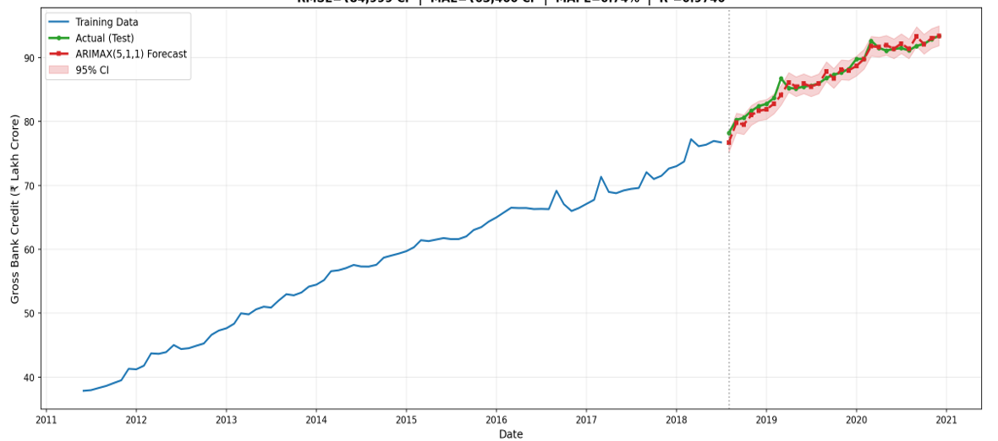
04
FORECAST ACCURACY
STEP 1
STEP 2
Variable | RMSE (Rs. Cr) | MAPE
GROSS BANK CREDIT | 98,001 | 0.8910%

Slide 29
05
FAVAR : FACTOR-AUGMENTED VECTOR AUTOREGRESSIVE
All these models include only a small number of variables. However, many macroeconomic indicators were observed when making decisions. If these variables are excluded, the estimated shocks may be mismeasured.
FAVAR fixes this by compressing 41 variables into 12 summary factors using PCA, and put these factors alongside the key policy variables into the VAR.
Observation equation: X_{t} = Λ^{f} F_{t} + Λ^{y} Y_{t} + e_{t}
Transition equation: [F_{t}, Y_{t}]' = Φ(L) · [F_{{t-1}}, Y_{{t-1}}]' + u_{t}
X_{t} : 41 macroeconomic variables. ( 32 after data cleaning)
F_{t} : Latent factors (12 for our dataset)
Y_{t} : Observed variables (Gross Credit Demand, Repo Rate).
Λ : Matrices of factor loadings
Φ(L) : Conformable lag polynomial of finite order d

Slide 30
05
DATA CLEANING & TRANSFORMATION
Variables Dropped
Transformations Applied
SDF Rate, Base Rate, MCLR, Term Deposit Rate FBIL
1. Log-Difference
Gross Credit, Repo Rate, INR/USD & INR/EUR (Exchange Rates) .
100% missing values — not available for study period
Incremental CD Ratio, Incr. Inv-Deposit Ratio
2. Forward-Fill + Back-Fill
Minor NAs in CPI (7 obs), 91-Day T-Bill (1 obs), WPI (1 obs) filled by carry-forward method.
Missing values + extreme outliers (max 748.8)
Reserve Repo Rate, Bank Rate
3. ADF Stationarity Test
Augmented Dickey-Fuller test at 5% significance. Non-stationary series (e.g. CD Ratio, CRR) first-differenced.
Nearly perfect collinearity with Repo & MSF Rate
Non-Food Credit
4. Standardization (Z-Score)
Sub-component of Gross Credit — severe multicollinearity
Before PCA, all X_{t} variables standardised to mean 0, std 1 , essential for PCA scale sensitivity.

Slide 31
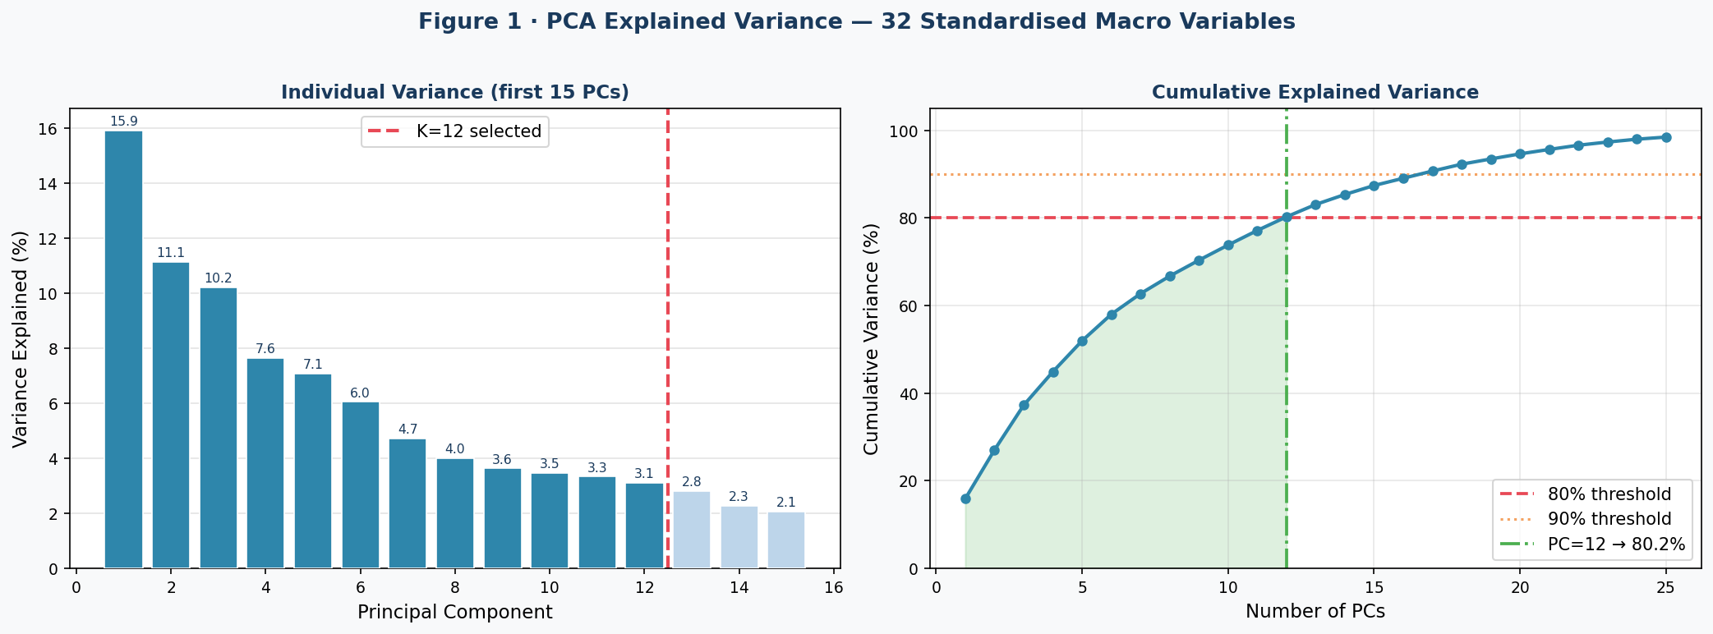
05
PCA – FACTOR EXTRACTION
Implementation Steps:
1
Standardised X_{t} (Z-score: mean=0, std=1) using only the training set
3
Selected 12 factors where cumulative variance ≥ 80%
2
Applied PCA on standardised X_{t} — extracted all components
4
Interpreting factors economically using factor loadings.

Slide 32
05
FACTOR INTERPRETATIONS
:
Factor | Name | Variance (%) | Key Variables
Factor 1 | Financial Tightness | 15.91% | 364-Day T-Bill, 91-Day T-Bill, MSF Rate
Factor 2 | Inflation | 11.13% | CPI, Primary Articles, Reserve Money
Factor 3 | Input Cost | 10.21% | WPI, Primary Articles, Fuel & Power
Factor 4 | Exchange Rate | 7.64% | INR-USD, INR-EUR, Call Money Rate
Factor 5 | Trade & External Demand | 7.06% | Imports, Exports, CRR
Factor 6 | Bank Deposit Rate & Credit Cycle | 6.04% | Term Deposit Rate, GBC growth
Factor 7 | Regulatory Liquidity (SLR) | 4.71% | SLR, Broad Money
Factor 8 | Real Activity & Money Supply | 4.01% | IIP, Broad Money, Deposits
Factor 9 | Lending Rate & Currency Differential | 3.63% | Base Rate, Exports, INR-EUR (−)
Factor 10 | Term Premium & Euro Exposure | 3.47% | TD Rate >1yr, INR-EUR, Base Rate
Factor 11 | Banking Sector Health | 3.33% | Base Rate, Broad Money, CD Ratio (−)
Factor 12 | Savings Rate & Retail Credit | 3.11% | Savings Deposit Rate, Imports

Slide 33
05
FAVAR MODEL – BUILDING THE VAR
Flow of the Model
X_{t} (40 vars)
PCA
F_{t} (12 factors)
+ Y_t
VAR(p)
Forecast
▶
▶
▶
Y_{t}
▶
VAR(p)
▶
Large Panel
Dimensionality Reduction
Latent Factors
Credit, Repo, CPI
Lag by AIC/BIC
Credit Growth
1
Combine Factors + Observed Vars
1
2
Lag Length Selection (AIC)
Z_{t} = [F₁t, F_{2t}, ..., F_{12t}, log Gross Credit, Repo Rate]. The input to the VAR model.
AIC : Lag 4 (AIC = −131)​
Lag 4 gives max eigenvalue = 0.958​

Slide 34
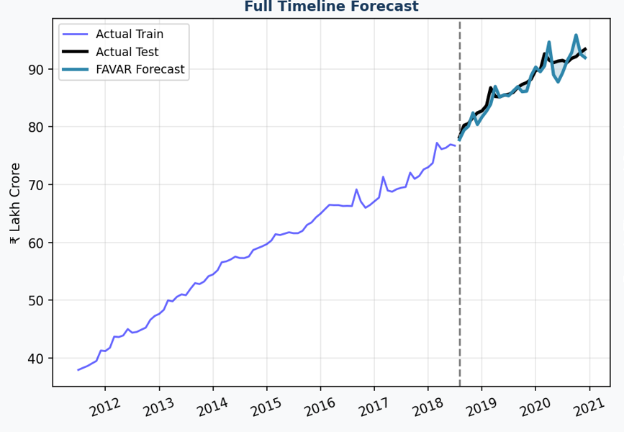
05
FORECAST ACCURACY
R²
Variable | RMSE (Rs. Cr) | MAPE
GROSS BANK CREDIT | 163,341 | 1.48%

Slide 35
COMPARISON
METHODS | RMSE (Rs Crore) | MAPE
HOLTS | 1408,776 | 14.66%
ARIMA | 309,724 | 3.289%
VECM | 383,269 | 4.08%
ARIMAX | 98,001 | 0.8910%
FAVAR | 163,341 | 1.4%
ARIMAX is the best-fit model for forecasting credit demand in this analysis

Slide 36
LIMITATONS
Unmodelled Structural Breaks Events like demonetization and COVID-19 were not built into the models, so predictions become less accurate during such sudden changes.
Limited Sample Size (N = 115) The data has only 115 observations, which limits how much information the models can learn.
Dependence on Past Data and Subjective Factor Interpretation
Models depend a lot on past data, so they struggle to predict new or unexpected situations, and in factor-based methods like PCA and FAVAR, the interpretation of factors is subjective and may not always be fully accurate.

Slide 37
FUTURE SCOPE
Include sudden shocks in models Future models can include things like COVID or demonetization, so predictions do not go wrong during such events.
Use more and better data Using more data (longer time or more frequent data) can help the model learn better.
Use advanced non-linear models Methods like Neural Networks, Random Forest, or XGBoost or Hybrid approaches (like combining ARIMA with machine learning models) can be used to capture complex patterns that simple models miss.

Slide 38
REFERENCES
Njenga, J. K. (2024, April 11). Domestic credit growth analysis using ARIMA technique: A case study of Kenya. University of Nairobi, Kenya.
Loves, L., Usman, M., Warsono, W., Widiarti, W., & Russel, E. (2020). Modeling multivariate time series by Vector Error Correction Models (VECM): Study of PT Kalbe Farma Tbk. and PT Kimia Farma (Persero) Tbk. Universitas Lampung, Indonesia.
Bernanke, B. S., Boivin, J., & Eliasz, P. (2004, January 1). Measuring the effects of monetary policy: A Factor-Augmented Vector Autoregressive (FAVAR) approach (NBER Working Paper No. 10220). National Bureau of Economic Research.
Szydlo, J. (2023, August 21). Forecasting credit dynamics: VAR, VECM or modern Factor-Augmented VAR approach. University of Warwick & Monash University.

Slide 39
THANK YOU

